Slide 1
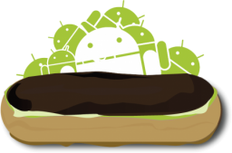
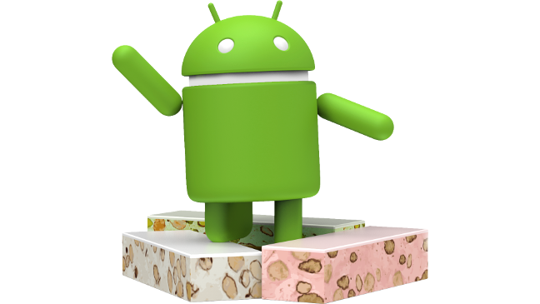
Android Evolution
2009 - 2017
Android enterprise
Ice Cream
Sandwich
Cupcake
Eclair
Gingerbread
KitKat
Marshmallow
Oreo
Donut
Froyo
Honeycomb
Jelly Bean
Lollipop
Nougat
Enterprise Mobility documentation by

